Slide 1

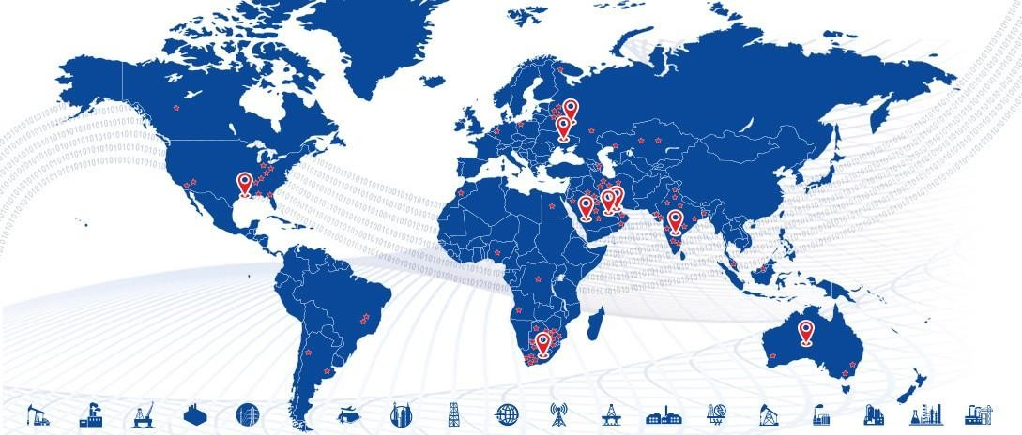

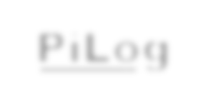










Material Master Data Cleansing & Governance Commercial Proposal
PiLog

Slide 2
Introduction
Dear Sir,
First, we would like to thank you for the opportunity granted to PiLog to submit a response to the request from Al-Hajri Corporation for the provisioning of Material Master Data Cleansing & Governance Solution Implementation
This document contains a preliminary commercial proposal for your kind reference with price validity for 60 Days
We shall remain at your disposal, In case you require any additional information.
We look forward to hearing from you and we assure of our utmost cooperation, at all times.
Sincerely,
Umar Farooq
Sales Head, PiLog Middle East
PiLog
www.piloggroup.com
2

Slide 3
Work Package 1: Data Cleansing and Standardization of Material Master
SN | Description | Tot. Items | Item Price USD | Total Price USD
1 | Material Master Data Cleansing & Standardization using PiLog’s i D Q M (iData Quality management) Tool Subscription and Mapping with UNSPSC Classification | 100 000 | 2.49 | 249,000
Total Cost (USD) |  |  |  | 249,000
Note: Additional items for data cleansing will be quoted as per the unit rate stated above
PiLog
www.piloggroup.com
3

Slide 4


Option 1:
Data Governance solution iMDRM (Master Data Record Manager)
On-Premise Implementation (Hardware & O racle Licenses to be Provided by Al-Hajri Corporation )

Slide 5
Work Package 2: Data Governance Tool Implementation ( (On-Premise) iMDRM: Master Data Record Manager
SN | Description | U O M | Item Price USD | Total Price USD | Recurring Cost USD (Yearly)
 |  |  |  | (One Time)
1 | Data Governance Solution i MDRM implementation and integration with SAP for Material Master | LS |  | 14,90,000
2 | i MDRM Licenses | 10 | 2400 | 24000
3 | AMC & Support for Material Master | Yearly |  |  | 15336
Total Cost |  |  |  | 15,14,000 | 15336
PiLog
www.piloggroup.com
5

Slide 6
Option 2:
Data Governance solution iMDRM (Master Data Record Manager) On-Cloud Implementation

Slide 7
Work Package 2: Data Governance Tool Implementation (On-Cloud)
SN | Description | U O M | Item Price USD | Total Price USD | Recurring Cost USD (Yearly)
 |  |  |  | (One Time)
1 | Data Governance Solution i MDRM implementation and integration with SAP for Material Master | LS |  | 14,90,000
2 | i MDRM Licenses | 10 | 2400 | 24000
3 | AMC & Support for Material Master | Yearly |  |  | 15336
4 | Cloud Subscription | Monthly |  | 3000 | 36000
Total Cost |  |  |  | 15,14,000 | 51336
PiLog
www.piloggroup.com
7

Slide 8
Payment Terms
Licenses: The Licenses amount for i MDRM Solution must be paid after the Project Kick-Off.
Note: If Al Gihaz would like to procure additional number of licenses it will be charged as per the Per unit License Value
iMDRM Implementation:
M ilestone 1: Project kick off – 15%
Milestone 2: Design and Build – 35 %
M ilestone 3: U AT Sign off and training – 40% Milestone 4: Production GO Live – 10%
AMC & Support/subscription: The AMC, Support and Subscription will be applicable After hyper care/Support period of 4 weeks
from the date of Go-Live
Data Cleansing Services Powered by i DQM solution: PiLog will send monthly invoice for the number of items submitted/approved – if items are not approved due to delay in QC process from client for 15 days it will be deemed approved
Payment to be released within 30 days from the date of submission of invoice
The Prices are exclusive of all Taxes
www.piloggroup.com

Slide 9

Add-On Components
Component Description | U O M | QTY | Price
PiLog Preferred Records License (Standard Subscription: 25,000 hits per year) | LS | 1 | $ 19,900.00
mBoM Governance | LS | 1 | $ 19,900.00
Asset Management (Equipments, Functional Location, eBoM, fBoM) Governance | EA | 1 | $ 29,900.00
InfoGraphics (KPI Reports, Dashboards for 4 roles, Data Quality, SLA & Monthly reports) | LS | 1 | $ 29,900.00
Cockpit View (Transactional Data Analytics, Real-time view of SAP data) | LS | 1 | $ 19,900.00
Workbench (Data Routing, Mass Data Approvals, Administration & Monitoring) | EA | 1 | $ 19,900.00
Mass Data Processing Workbench for Materials: Create , Change & Extension) | LS | 1 | $ 40,000.00
Bulk De-duplication & Resolution (Smart Consolidation module) | LS | 1 | $ 19,900.00
Financial Assets Management (On-Cloud) (Fixed Asset Register) | Block | 1 | $ 39,900.00
Integration with Active Directory [SSO, MS IIS] | LS | 1 | $ 24,900.00
Material Criticality Analysis (1 Block = 20,000 records) | Block | 1 | $ 19,900.00
Outsourcing the Master Data Functional Specialist function to PiLog (Responsible for entire reporting, functional assistance & data quality analysis) (per month) | Monthly | 1 | $ 6500.00
www.piloggroup.com

Slide 10
Copyright
© PiLog 2022
All Rights Reserved PiLog Group
Notice
The information in this document shall not be disclosed outside of the recipient’s organization and shall not be duplicated, used or disclosed in whole or in part for any purpose other than to evaluate the proposal, provided that if a confidential & NDA is signed between the parties, The recipient shall have the right to duplicate, use or disclose the information to the extent provided in the contract. This restriction does not limit the right of recipient to use information contained in the proposal if it is obtained from another source without restriction.
www.piloggroup.com

